Slide 1

Chapter
8
Tapping into Global Markets

Slide 2
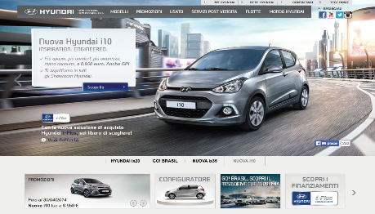
Learning Objectives
What factors should a company review before deciding to go abroad?
How can companies evaluate and select specific international markets to enter?
What are the differences between marketing in a developing and a developed market?
What are the major ways of entering a foreign market?
To what extent must the company adapt its products and marketing program to each foreign country?
How do marketers influence country-of-origin effects?

Slide 3
Competing on a Global Basis
Global industry
  Competitors’ strategic positions in major geographic or national markets are affected by their overall global positions
Global firm
  Operates in more than one country and captures R&D, production, logistical, marketing, and financial advantages not available to purely domestic competitors
Notes:
Global competition is intensifying in more product categories as new firms make their mark on the international stage. Competition from developing-market firms is also heating up. Although some U.S. businesses may want to eliminate foreign competition through protective legislation, the better way to compete is to continuously improve products at home and expand into foreign markets. Global firms plan, operate, and coordinate their activities on a worldwide basis.

Slide 4
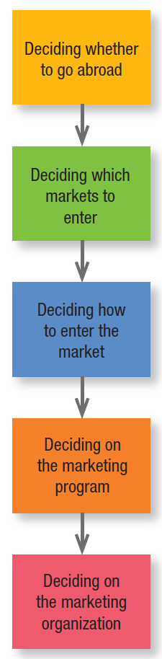
Figure 8.1
Decisions In International Marketing
Notes:
For a company of any size or any type to go global, it must make a series of decisions (see Figure 8.1).

Slide 5
Deciding Whether to Go Abroad
Factors that draw companies into the international arena
  Some international markets present better profit opportunities than domestic market
  Firm needs larger customer base to achieve economies of scale
  Firm wants to reduce dependence on any one market
  Firm counterattacks global competitors in home markets
  Customers going abroad require international service
Notes:
Most companies would prefer to remain domestic if their domestic market were large enough. Managers would not need to learn other languages and laws, deal with volatile currencies, face political and legal uncertainties, or redesign their products to suit different customer needs and expectations. Business would be easier and safer.

Slide 6
Deciding Whether to Go Abroad
Before making a decision to go abroad, the company must also weigh several risks
  Firm might not understand foreign preferences, failing to offer competitively attractive product
  Firm might not understand foreign country’s culture
  Firm might underestimate foreign regulations and incur unexpected costs
  Firm might lack managers with international experience
  Foreign country might change commercial laws, devalue currency, or expropriate foreign property
Notes:
Some companies don’t act until events thrust them into the international arena.

Slide 7
Internationalization Process
Stage 1: No export activities
Stage 2: Export via independent representatives
Stage 3: Establishment of sales subsidiaries
Stage 4: Establishment of production facilities abroad
Notes:
The first task is to move from stage 1 to stage 2. Most firms work with an independent agent and enter a nearby or similar country. Later, the firm establishes an export department to manage its agent relationships. Still later, it replaces agents with its own sales subsidiaries in its larger export markets. This increases investment and risk but
also earning potential. Next, to manage subsidiaries, the company replaces the export department with an international department or division. If markets are large and stable or the host country requires local production, the company will locate production facilities there. By this time, the firm is operating as a multinational and optimizing its sourcing, financing, manufacturing, and marketing as a global organization.

Slide 8
Deciding Which
Markets to Enter
How many markets to enter
Waterfall Approach
Sprinkler Approach
Born Global
Notes:
The company must decide how many countries to enter and how fast to expand. Typical entry strategies are the waterfall approach, gradually entering countries in sequence, and the sprinkler approach, entering many countries simultaneously. Increasingly, firms—especially technology-intensive firms or online ventures—are born global and market to the entire world from the outset.

Slide 9
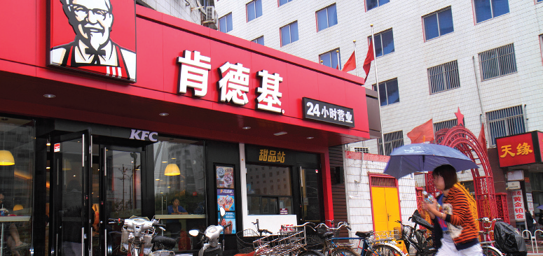
Evaluating
Potential Markets
Neighboring countries
Psychic proximity/cultural distance
Fewer countries
Notes:
However much nations and regions integrate their trading policies and standards, each market still has unique features. Readiness for different products and services and attractiveness as a market depend on the market’s demographic, economic, sociocultural, natural, technological, and political-legal environments. Many companies prefer to sell to neighboring countries because they understand them better and can control their entry costs more effectively. At other times, psychic proximity determines choices. Given more familiar language, laws, and culture, many U.S. firms prefer to sell in Canada, England, and Australia rather than in larger markets such as Germany and France. Companies should be careful, however, in choosing markets according to cultural distance. Besides overlooking potentially better markets, they may only superficially analyze real differences that put them at a disadvantage. It often makes sense to operate in fewer countries, with a deeper commitment and penetration in each.

Slide 10

Succeeding in Developing Markets
BRICS
  Brazil, Russia, India, China, and South Africa
CIVETS
  Columbia, Indonesia, Vietnam, Egypt, Turkey, and South Africa
Notes:
The unmet needs of the developing world represent huge potential markets for food, clothing, shelter, consumer electronics, appliances, and many other goods. Many market leaders are relying on developing markets to fuel their growth. The world’s largest food company now gets about 40 percent of its revenue from emerging markets. Developing markets account for about 82 percent of the world’s population, and 90 percent of future population growth is projected to occur there.

Slide 11
Succeeding in Developing Markets
Brazil
  Biggest economy in Latin America
  Sixth largest economy in the world
Fifth-largest country of digital users
High cost of transporting products
Crime and corruption exist
Notes:
Brazil boasts large and well-developed agricultural, mining, manufacturing, and service sectors.

Slide 12
Succeeding in Developing Markets
Russia
  Largest exporter of natural gas
  Second-largest exporter of oil
Third-largest exporter of steel/aluminum
Make heavy use of social media
Dwindling workforce/poor infrastructure
Notes:
The Organization for Economic Cooperation & Development (OECD) cautions that economic reforms have stagnated and ranks Russia as one of the most corrupt countries in the world. Many feel the government of Vladimir Putin has been unpredictable and difficult to work with. For these and other reasons, market entry can be daunting.

Slide 13
Succeeding in Developing Markets
India
  Lively democracy/youthful population
  World’s second most populous nation
One of the youngest large economies
Has fully embraced mobile technology
Poor infrastructure/public services
Notes:
The national government in New Delhi vows to spend $1 trillion on infrastructure over five years, although, as in many emerging markets, corruption remains a huge problem at virtually all levels of government. A complicated retail network has been slow to modernize, leading to distribution problems.

Slide 14
Succeeding in Developing Markets
China
  Largest auto market in the world
  Emerging urban middle class
World’s top consumer of luxury goods
Fierce competition among foreign firms
Opaque and arbitrary bureaucracy
Notes:
Foreign businesses complain about subsidized competition, restricted access, conflicting regulations, opaque and seemingly arbitrary bureaucracy, and lack of protection for intellectual property; 90 percent of PC software is reportedly pirated in China. The Chinese government encourages partnerships with foreign companies, in part so
that its firms can learn enough to become global powerhouses themselves.

Slide 15
Succeeding in Developing Markets
South Africa
  Access point to the African region
  Increasing discretionary income
  Consumers are brand conscious
  Increasing reliance on mobile phones
  Logistical/infrastructure problems
Notes:
Africa has experienced much change in recent years. Although political turmoil in Egypt, Tunisia, and Libya during the “Arab Spring” is a reminder of the instability that has plagued the continent and logistical and infrastructure problems prevail, improvements in many other areas such as health, education, and social services paint a rosier picture of the continent’s future, as do economic forecasts. McKinsey Global Institute estimates the number of African households with discretionary income—money available to spend on items other than food—is expected to increase by a robust 50 percent to 128 million people by 2020.

Slide 16
Succeeding in Developing Markets
Indonesia
  Increasing political stability
  Increasing economic growth
  Largest Muslim country
  Consumers are brand conscious
  Distribution/infrastructure limitations
Notes:
Indonesia’s reputation as a country historically struggling with natural disasters, terrorism, and economic uncertainty is quickly being replaced by a profile of political stability and economic growth. The fourth largest country in the world and the largest Muslim country, given all its progress, Indonesia strikes many as ready
to join the BRICS countries.

Slide 17
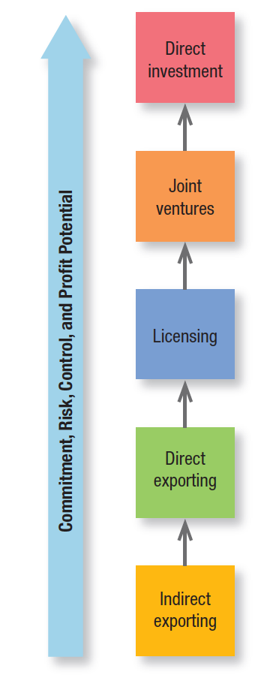
Figure 8.2
Modes of Foreign Market Entry
Notes:
Once a company decides to target a particular country, it must choose the best mode of entry with its brands. Its broad choices are indirect exporting, direct exporting, licensing, joint ventures, and direct investment, shown in Figure 8.2. Each succeeding strategy entails more commitment, risk, control, and profit potential.

Slide 18
Deciding How to Enter the Market
Indirect exporting
  Working through independent intermediaries
Domestic-based export merchants
Domestic-based export agents
Cooperative organizations
Export-management companies
Notes:
Companies typically start with export, specifically indirect exporting—that is, they work through independent intermediaries. Domestic-based export merchants buy the manufacturer’s products and then sell them abroad.
Domestic-based export agents, including trading companies, seek and negotiate foreign purchases for a commission. Cooperative organizations conduct exporting activities for several producers—often of primary products such as fruits or nuts—and are partly under their administrative control. Export-management companies agree to manage a company’s export activities for a fee.

Slide 19
Deciding How to Enter the Market
Direct exporting
  Handling one’s own exports
Domestic-based export department
Overseas sales branch
Traveling export sales representatives
Foreign-based distributors
Notes:
Companies may eventually decide to handle their own exports. The investment and risk are somewhat greater, but so is the potential return. Direct exporting happens in several ways:
Domestic-based export department or division. A purely service function may evolve into a self-contained export department operating as its own profit center.
Overseas sales branch or subsidiary. The sales branch handles sales and distribution and perhaps warehousing and promotion as well. It often serves as a display and customer service center.
Traveling export sales representatives. Home-based sales representatives travel abroad to find business.
Foreign-based distributors or agents. These third parties can hold limited or exclusive rights to represent the company in that country.

Slide 20
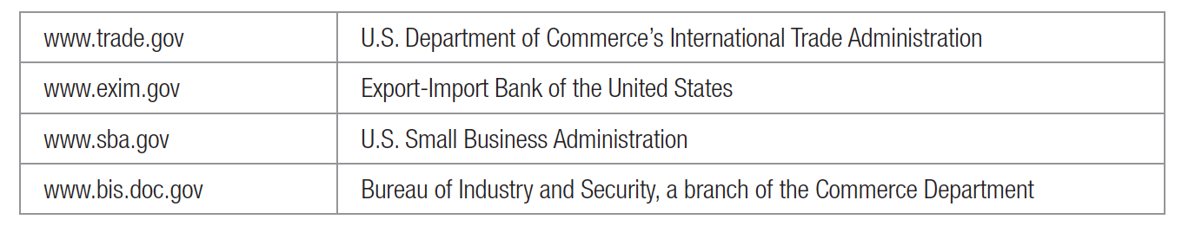
Free information about trade and exporting
Notes:
Successful companies adapt their Web sites to provide country-specific content and services to their highest-potential international markets, ideally in the local language. Finding free information about trade and exporting has never been easier. Here are some places to start a search. Many states’ export-promotion offices also have online resources and allow businesses to link to their sites.

Slide 21

Deciding How to Enter the Market
Licensing
  Licensor issues a license to a foreign company to use a manufacturing process, trademark, patent, trade secret, or other item of value for a fee or royalty
Notes:
Licensing arrangements vary. Companies such as Hyatt and Marriott sell management contracts to owners of foreign hotels to manage these businesses for a fee. In contract manufacturing, the firm hires local manufacturers to produce the product. Finally, a company can enter a foreign market through franchising, a more complete
form of licensing. The franchisor offers a complete brand concept and operating system. In return, the franchisee invests in and pays certain fees to the franchisor.

Slide 22
Deciding How to Enter the Market
Joint ventures
  Foreign investors have often joined local investors in a joint venture company in which they share ownership and control
Direct Investment
  The foreign company can buy part or full interest in a local company or build its own manufacturing or service facilities
Notes:
A joint venture may be necessary or desirable for economic or political reasons. The foreign firm might lack the financial, physical, or managerial resources to undertake the venture alone, or the foreign government might require joint ownership as a condition for entry.
If the market is large enough, direct investment offers distinct advantages. First, the firm secures cost economies through cheaper labor or raw materials, government incentives, and freight savings. Second, the firm strengthens its image in the host country because it creates jobs. Third, the firm deepens its relationship with the
government, customers, local suppliers, and distributors, enabling it to better adapt its products to the local environment. Fourth, the firm retains full control over its investment and can develop manufacturing and marketing policies that serve its long-term international objectives. Fifth, the firm ensures its access to the market in case the host country insists that locally purchased goods must have domestic content.

Slide 23
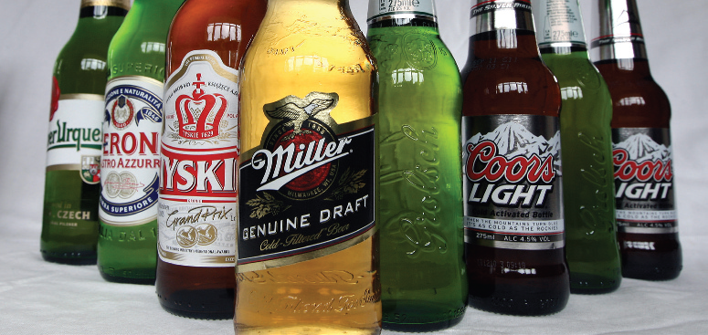

Deciding How to Enter the Market
Acquisition
  Acquiring local brands for their brand portfolio
Notes:
Rather than bringing their brands into certain countries, many companies choose to acquire local brands for their brand portfolio. Strong local brands can tap into consumer sentiment in a way international brands may find difficult. A good example of a company assembling a collection of “local jewels” is SABMiller.

Slide 24
Deciding on the Marketing Program
Advantages
Economies of scale
Lower marketing costs
Power and scope
Consistency in brand image
Ability to leverage good ideas
Uniformity of marketing practices
Disadvantages
Differences in consumer needs, wants, usage patterns
Differences in consumer response to marketing programs
Differences in brand development process
Differences in legal environment

Slide 25
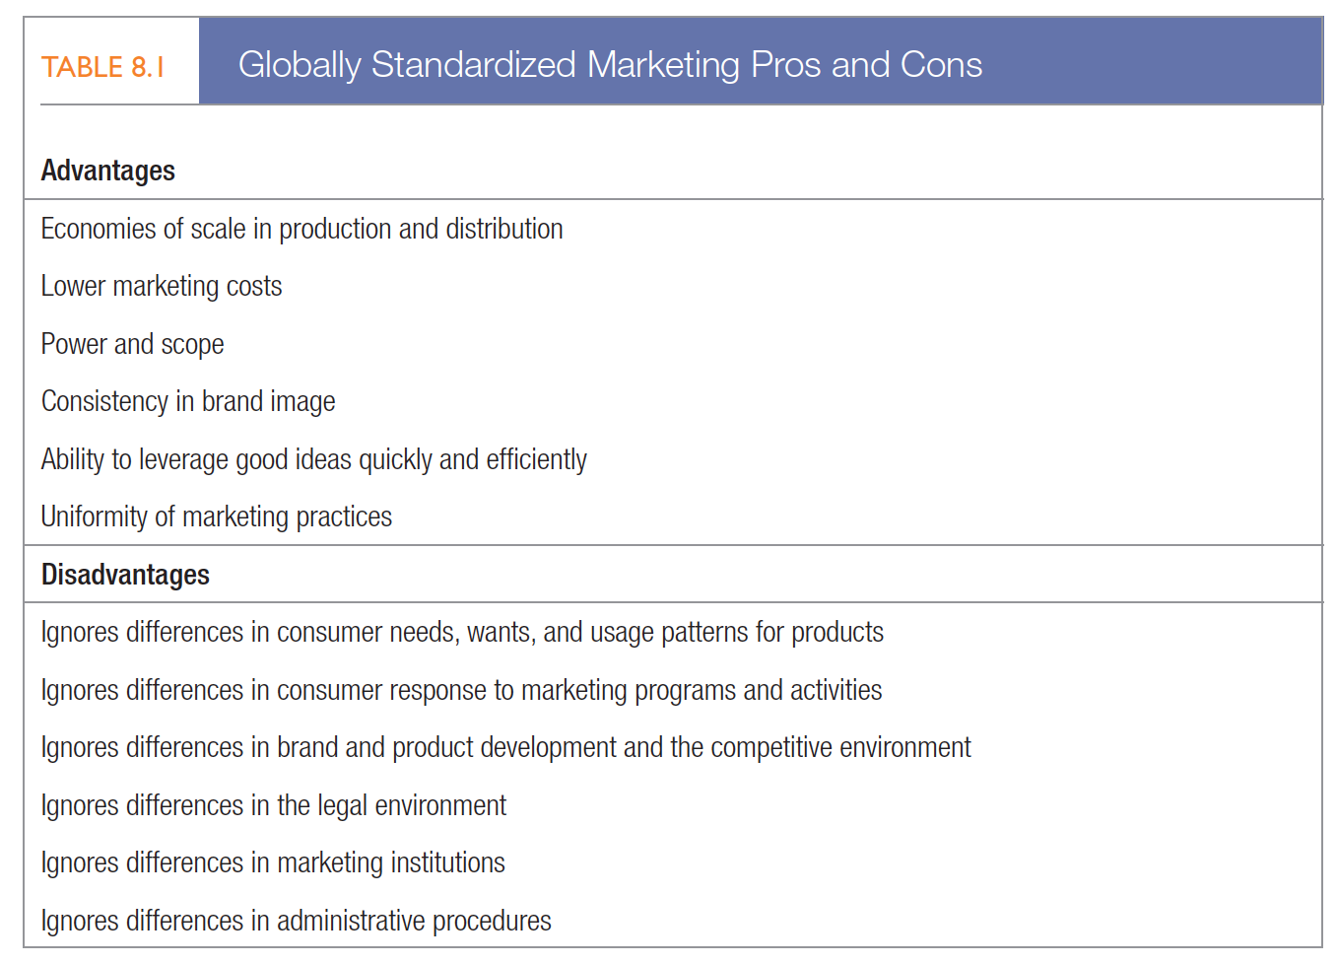
Deciding on the Marketing Program

Slide 26
Deciding on the Marketing Program
Global similarities and differences
  The Internet, cable and satellite TV, and global linking of telecommunications networks have led to a convergence of lifestyles
Hofstede four cultural dimensions
  Individualism versus collectivism
  High versus low power distance
  Masculine versus feminine
  Weak vs. strong uncertainty avoidance
Notes:
Increasingly shared needs and wants have created global markets for more standardized products, particularly among the young middle class.
Consumer behavior may reflect cultural differences that can be pronounced across countries. Hofstede identifies four cultural dimensions that differentiate countries:
1. Individualism versus collectivism—In collectivist societies, the self-worth of an individual is rooted more in the social system than in individual achievement (high collectivism: Japan; low: United States).
2. High versus low power distance—High power distance cultures tend to be less egalitarian (high: Russia; low: Nordic countries).
3. Masculine versus feminine—This dimension measures how much the culture reflects assertive characteristics more often attributed to males versus nurturing characteristics more often attributed to females (highly masculine: Japan; low: Nordic countries).
4. Weak versus strong uncertainty avoidance—Uncertainty avoidance indicates how risk-aversive people are (high avoidance: Greece; low: Jamaica).

Slide 27
Marketing Adaptation
Product features
Labeling
Colors
Materials
Sales promotion
Prices
Advertising media
Brand name
Packaging
Advertising execution
Advertising themes
Notes:
Because of all these differences, most products require at least some adaptation. Even Coca-Cola is sweeter or less carbonated in certain countries. Rather than assuming it can introduce its domestic product “as is” in another country, a company should review the following elements and determine which add more revenue than cost if adapted.

Slide 28
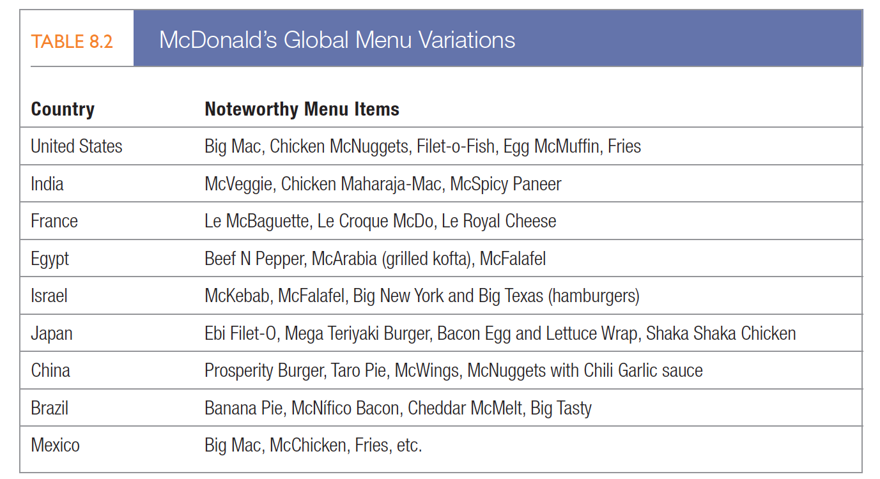
Marketing adaptation
Notes:
McDonald’s allows countries and regions to customize its basic layout and menu staples (see Table 8.2). In cities plagued by traffic tie-ups like Manila, Taipei, Jakarta, and Cairo, McDonald’s delivers via fleets of motor scooters.

Slide 29

Global product strategies
Product standardization
Notes:
Some products cross borders without adaptation better than others, and consumer knowledge about new products is generally the same everywhere because perceptions have yet to be formed. Many leading Internet brands—such as Google, eBay, Twitter, and Facebook—made quick progress in overseas markets.

Slide 30
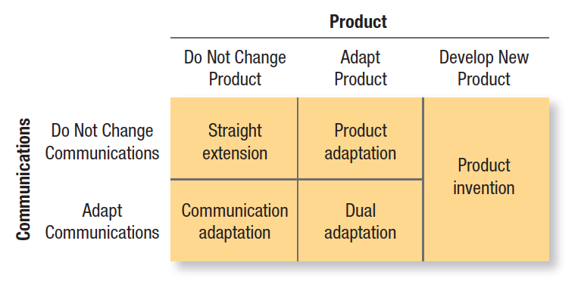
Figure 8.3
Product & Communication Strategies
Notes:
Warren Keegan has distinguished five product and communications adaptation strategies (see Figure 8.3). Straight extension introduces the product in the foreign market without any change. Product adaptation alters the product to meet local conditions or preferences. Flexible manufacturing makes it easier to do so on several levels. Changing marketing communications for each local market is a process called communication adaptation. If it adapts both the product and the communications, the company engages in dual adaptation.

Slide 31
Global product strategies
Product invention
  Backward invention: reintroduces earlier product forms well adapted to a foreign country’s needs
  Forward invention: creates a new product to meet a need in another country
Notes:
Product invention creates something new. It can take two forms:
Backward invention reintroduces earlier product forms well adapted to a foreign country’s needs. A big hit in developing markets in Latin America, Mexico, and the Middle East, the powdered drink Tang has added local flavors like lemon pepper and soursop. Although its U.S. sales have fallen precipitously, its worldwide sales doubled from 2006 to 2011.
Forward invention creates a new product to meet a need in another country. Less-developed countries need low-cost, high-protein foods. Companies such as Quaker Oats, Swift, and Monsanto have researched their nutrition requirements, formulated new foods, and developed advertising to gain product trial and acceptance.

Slide 32
Global Pricing Strategies
Companies have three choices for setting prices in different countries
Uniform price everywhere
Market-based price
Cost-based price
Notes:
Companies have three choices for setting prices in different countries:
1. Set a uniform price everywhere. PepsiCo might want to charge $1 for Pepsi everywhere in the world, but then it would earn quite different profit rates in different countries. Also, this strategy would make the price too high in poor countries and not high enough in rich countries.
2. Set a market-based price in each country. PepsiCo would charge what each country could afford, but this strategy ignores differences in the actual cost from country to country. It could also motivate intermediaries in low-price countries to reship their Pepsi to high-price countries.
3. Set a cost-based price in each country. Here PepsiCo would use a standard markup of its costs everywhere, but this strategy might price it out of markets where its costs are high.

Slide 33

Global Pricing Strategies
Transfer price
Dumping
Arm’s-length price
Gray markets
Counterfeit products
Notes:
A different problem arises when one unit charges another unit in the same company a transfer price for goods it ships to its foreign subsidiaries. If the company charges a subsidiary too high a price, it may end up paying higher tariff duties, though it may pay lower income taxes in the foreign country. If the company charges its subsidiary too low a price, it can be accused of dumping, charging either less than its costs or less than it charges at home in order to enter or win a market. Various governments are watching for abuses and often force companies to charge the arm’s-length price—the price charged by other competitors for the same or a similar product.
Many multinationals are plagued by the gray market, which diverts branded products from authorized distribution channels either in-country or across international borders. Often a company finds some enterprising distributors buying more than they can sell in their own country and reshipping the goods to another country to take advantage of price differences.
As companies develop global supply chain networks and move production farther from home, the chance for corruption, fraud, and quality-control problems rises. Sophisticated overseas factories seem able to reproduce almost anything. Name a popular brand, and chances are a counterfeit version of it exists somewhere in the world.

Slide 34
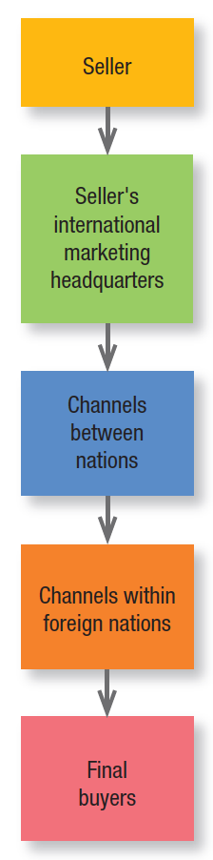
GLOBAL DISTRIBUTION STRATEGIES
Channel entry
  Figure 8.4: Whole-Channel Concept for International Marketing
Channel differences
  Various distribution systems
  Size and character of retail units
Notes:
Figure 8.4 shows three links between the seller and the final buyer. In the first, seller’s international marketing headquarters, the export department or international division makes decisions about channels and other marketing activities. The second link, channels between nations, gets the products to the borders of the foreign nation. Decisions made in this link include the types of intermediaries (agents, trading companies), type of transportation (air, sea), and financing and risk management. The third link, channels within foreign nations, gets products from their entry point to final buyers and users.
Distribution channels across countries vary considerably. To sell consumer products in Japan, companies must work through one of the most complicated distribution systems in the world. Another difference is the size and character of retail units abroad. Large-scale retail chains dominate the U.S. scene, but much foreign retailing is in the hands of small, independent retailers.

Slide 35
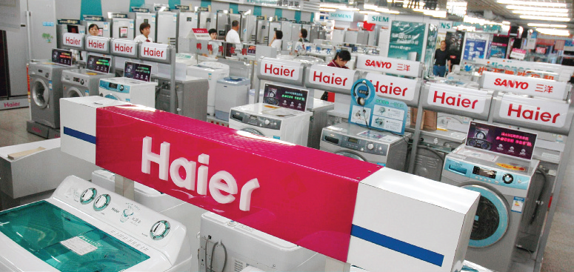
Country-of-Origin Effects
Mental associations and beliefs triggered by a country
Notes:
Government officials want to strengthen their country’s image to help domestic marketers that export and to attract foreign firms and investors. Marketers want to use positive country-of-origin perceptions to sell their products and services. Governments now recognize that the images of their cities and countries affect more than tourism and have important value in commerce. Foreign business can boost the local economy, provide jobs, and improve infrastructure. Image can also help sell products.
Global marketers know that buyers hold distinct attitudes and beliefs about brands or products from different countries. These perceptions can be attributes in decision making or influence other attributes in the process (“If it’s French, it must be stylish”). Coca-Cola’s success against local cola brand Jianlibao in China was partly due
to its symbolic values of U.S. modernity and affluence.

Slide 36


